Slide 1
WELCOME!
ATRIO Health Plans
Presentation will begin shortly
[Agent Name]
Licensed Sales Agent
[Agent Phone]
[Agent Email]
Confidential - Not Intended for Distribution

Slide 2
Local Licensed Sales Agent
Service area: [ ]
Certified to sell ATRIO Health Plans [of years]
Licensed in [states]
Languages spoken: [languages]
Community Involvement: Volunteer through [organization name]
[Agent Name]
Telephone
[123-456-7890]
Email
[hello@reallygreatsite.com]
Visit our ATRIO website
atriohp.com
Confidential - Not Intended for Distribution

Slide 3
Agenda
Why ATRIO
Understanding your Medicare Choices
Prescription Drug Coverage
Eligibility and Enrollment
2025 Medicare Advantage Plan Information
Additional Resources
Confidential - Not Intended for Distribution

Slide 4
WHY ATRIO HEALTH PLANS
Tip: Collaboration makes teamwork easier! Click "Share" and invite your teammates to fill this up. Use this page for bulletins, brainstorms, and other fun team ideas.
Right-click on the background of the slide, or on the thumbnail below, for the option to expand this page into a whiteboard for more space!
For over 20 years, ATRIO has delivered high-quality health insurance at a reasonable price, leveraged the talents of our people, and fostered deeper community connections.
Local Customer Service excellence with walk-in availability
Physician-led care coordination programs
Member Educational Meetings
Oregon-Grown Company with world-wide benefit
Access to quality care
One of the fastest-growing Medicare Advantage plans
Confidential - Not Intended for Distribution

Slide 5
When is someone eligible for Medicare?
Legal residents must live in the U.S. for at least 5 years in a row, including the 5 years just before applying for Medicare.
To be eligible for Medicare, you must be a U.S. citizen or legal resident AND you must meet one or more of the following requirements:
OR
OR
Age 65 years or older
Younger than 65 with a qualifying disability
Any age with a diagnosis of end-stage renal disease or ALS
Confidential - Not Intended for Distribution

Slide 6
Understanding the Four Parts of Medicare
Part A
Helps pay for hospital stays and inpatient care
Part B
Helps pay for provider visits and outpatient care
Part C
Combines Part A (hospital insurance and Part B (medical insurance) and additional benefits all in one plan
Part D
Prescription Drugs
Original Medicare
Provided by the Federal government
Offered by Medicare-approved private companies
Confidential - Not Intended for Distribution

Slide 7
Eligibility and Enrollment
When can you enroll in a Medicare Advantage or prescription drug plan?
Initial Enrollment Period
Initial Enrollment Period (IEP) is 7 months long. It includes your 65th birthday month plus the 3 months before and the 3 months after. It begins and ends on the first of the month. You may enroll in Part A, Part B or both.
You may also choose to join a Medicare Advantage plan (Part C) or a prescription drug plan (Part D).
Although you are not required to enroll in a Part D, there may be an additional amount charged by Medicare that will be added to your Part D premium if you don’t enroll in prescription drug coverage, or you didn’t enroll in a prescription drug coverage within 63 days of losing your creditable drug coverage.
Confidential - Not Intended for Distribution

Slide 8
Eligibility and Enrollment
Annual Enrollment Period
October 15-December 7
During annual enrollment, you can add, drop or switch your Medicare coverage
Medicare Advantage Open Enrollment Period
January 1-March 31
If you’re already a Medicare Advantage plan member, you may disenroll from your current plan and either switch to a different Medicare Advantage plan one time only, or go back to Original Medicare during this period
Special Enrollment Period
Depending on certain circumstances, you may be able to enroll in a Medicare plan outside of the annual enrollment period. Some ways you may qualify for a Special Enrollment Period are if you:
Retire and lose your employer coverage
Move out of the plan’s service area
Qualify for
Extra Help
Have been diagnosed with certain qualifying chronic health conditions
Special needs plans have other eligibility requirements
Confidential - Not Intended for Distribution

Slide 9
Understanding your Medicare Choices
Option 1
Add one or both of the following to Original Medicare:
Option 2
Choose a Medicare Advantage plan:
Medicare Supplement Insurance
Offered by private companies
Medicare Advantage Plan
Offered by Medicare-approved private companies
or
Helps pay some or all the costs not covered by Original Medicare
Part C
Combines Part A (hospital insurance) and Part B (medical insurance) in one plan
Medicare Part D Plan
Offered by Medicare-approved private companies
Part D
Often includes prescription drug coverage
Helps pay for prescription drugs
May offer additional benefits not provided by Original Medicare
Confidential - Not Intended for Distribution

Slide 10
When you choose a Medicare Advantage Plan: (Part C)
Things to know about Medicare Advantage
You must continue to pay your Medicare Part B premium
You may qualify for financial assistance
If you enroll in Part D late, you may pay a penalty
Medicare Advantage offers the same protections as Original Medicare and many more
May include prescription drug coverage
May offer additional benefits like dental, vision, hearing and wellness benefits
Confidential - Not Intended for Distribution

Slide 11
Prescription Drug Coverage
What’s the difference between total drug costs and out-of-pocket costs?
Total drug costs
What you pay for prescription drugs each year, plus what your plan pays. Does not include your monthly plan premium.
Out-of-pocket drug costs
The total amount you pay for your covered prescription drugs, and any discounts paid by drug manufacturers. This does not include your monthly plan premium.
Extra Help is a program for people with limited income who need help paying for Medicare Part D prescription drug costs. This includes deductibles and copays and other costs.
Confidential - Not Intended for Distribution

Slide 12
Prescription Drug Coverage
Understanding Medicare drug payment stages
Your prescription drug costs change during the year, depending on which payment stage you are in. The payment stages start over on January 1 including annual deductible stage and the dollar limits in each stage may change each year. The coverage limits are determined by benchmarks set by the Centers for Medicare & Medicaid Services (CMS).
Payment stages | Member typically pays | Plan typically pays
Annual Deductible | 100% until you reach the plan deductible | 0%
Initial Coverage | Your copay will depend on which tier the drug is in, check your formulary to the tiers and a list of covered drugs
Catastrophic Coverage Stage: After you have paid $2,000 out of pocket, you move to the Catastrophic Coverage Stage. In the Catastrophic Stage the plan pays 100% of your drug costs | $2,000 maximum | 100% after the $2,000 is met
Confidential - Not Intended for Distribution

Slide 13
Prescription Drug Coverage
Pharmacy network
You may save on prescriptions by using in-network retailers
Save one month’s copay by switching to a 90-day supply at a network retail or mail-order pharmacy. Ask your doctor about a 100-day supply and save more (restrictions apply)
Drug list (formulary)
Tiered formulary
Tier 1 - Preferred generic drugs
Tier 2 - Generic drugs
Tier 3 - Preferred brand drugs
Tier 4 - Non-preferred drugs
Tier 5 - Specialty drugs
Tier 6*- Select Care Drugs
*Tier 6 is a $0 copay tier for certain important medications such as:
Part D vaccines
ACE-I/ARBs for treatment of high blood pressure or kidney protection
Select antidiabetic drugs to treat diabetes
Statins to treat high cholesterol
Under the Inflation Reduction Act (IRA) You won’t pay more than $35 for a 30-day supply of each insulin product covered by our plan, no matter what cost-sharing tier it is on, even if you haven’t paid your deductible.
Confidential - Not Intended for Distribution

Slide 14
Prescription Drug Coverage
Step therapy
ATRIO Health Plans can help you save monthly on your prescriptions by offering lower-cost drugs that can treat the same medical condition as your current brand name drugs.
Quantity limits
Some drugs have quantity limits, where the plan will cover only a certain amount of drug for one copay or over a certain number of days. The limits may be in place to ensure safe and effective use of the drug.
Prior authorization
Before the plan will cover certain drugs, it may need more information from your provider to make sure the drug is being used correctly for a medical condition covered by Medicare. You may be required to try a different drug before the plan will cover the prescribed drug.
Part B vs. Part D Review
Some drugs are covered as part of your medical Part B coverage, and others are covered under your Part D coverage.
Asking for an exception
If you need a drug that’s not currently covered by your plan, you may:
Ask the plan to cover your drug even if it is not on the drug list. This is known as a formulary exception.
Ask to waive coverage restrictions or limits on your drug. This is known as a utilization exception.
Coverage decisions
If your doctor has submitted an exception request on your behalf, generally the plan will make a decision within 72 hours. You can request an expedited or fast, decision if you or your doctor believes your health requires it.
Confidential - Not Intended for Distribution

Slide 15
Prescription Drug Coverage
Medicare Prescription Payment Plan Program (M3P/MPPP)
Medicare
Part of the IRA (Inflation Reduction Act)
The M3P is a new program starting January 1, 2025
Enrollment in the M3P is optional, members can enroll anytime beginning October 15 for January enrollment and anytime during the plan year
Prescription
Part D Drug Plans only
Medicare/CMS covered Drugs only
Payment
Out-of-pocket prescription drug expenses
Plan
Payments made in monthly installments over the course of the plan year.
Confidential - Not Intended for Distribution

Slide 16
Prescription Drug Coverage
Medicare Prescription Payment Plan Program (M3P/MPPP)
How it works
All members with plans that include Part D (Rx) coverage are eligible to opt-in to the M3P program
Members have the option to opt-in or opt-out of the M3P program at any time
Members with high prescription costs are likely to benefit the most from the M3P program] [Members with prescription drug costs that total the annual maximum out-of-pocket of $2,000 or more in prior years benefit the most from the M3P program
Members who enroll and qualify in the M3P program, will pay $0 to the pharmacy for covered Part D drugs
Members will then be billed monthly by ATRIO Health Plans for the cost of their prescriptions. Calculations for monthly payments are based on the annual $2,000 out-of-pocket maximum as well as prescription costs incurred each prior month.
Members who receive Extra Help from Medicare with your Part D costs, are also eligible for this program
Confidential - Not Intended for Distribution

Slide 17
Prescription Drug Coverage
Medicare Prescription Payment Plan Program (M3P/MPPP)
Calculation Example
Scenario: You take several high-cost drugs that have a total out-of-pocket cost of $500 each month. In January 2025, you join the Medicare Prescription Payment Plan through your Medicare drug plan or Medicare health plan with drug coverage.
January 2025
$2,000 [annual out-of-pocket maximum]
-$0 [no OOP costs before using payment option]
= $2000
_______________
12 [months remaining in the year] = $166.67 [payment for January]
February 2025
$333.33 [remaining balance from January] + $500 [new costs for Feb]
= $833.33
______________
11 [months remaining in the year] = $75.76 [payment for February]
March 2025
$757.57 [remaining from Jan + Feb] +$500 [new costs for Mar}
= $1,257.57
___________________
10 [months remaining in the year] = $125.76 [payment for March]
Confidential - Not Intended for Distribution

Slide 18
2025 ATRIO HEALTH PLANS INFORMATION
Confidential - Not Intended for Distribution

Slide 19
2025 Enrollment Kit and Benefits
We will Cover:
2025 ATRIO Plan Benefits
Supplemental Benefits
Star Ratings
How to Enroll
Plan Recap
After you Enroll
Notice of Nondiscrimination & Multi-Language Resources
Confidential - Not Intended for Distribution

Slide 20
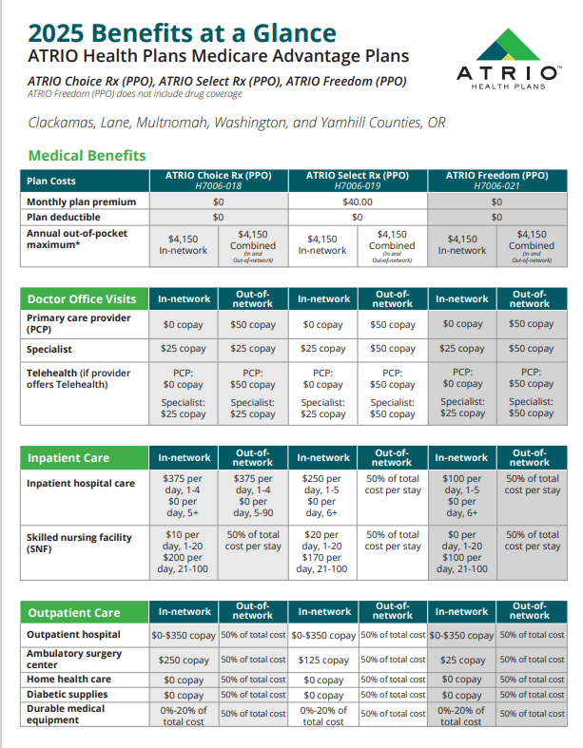
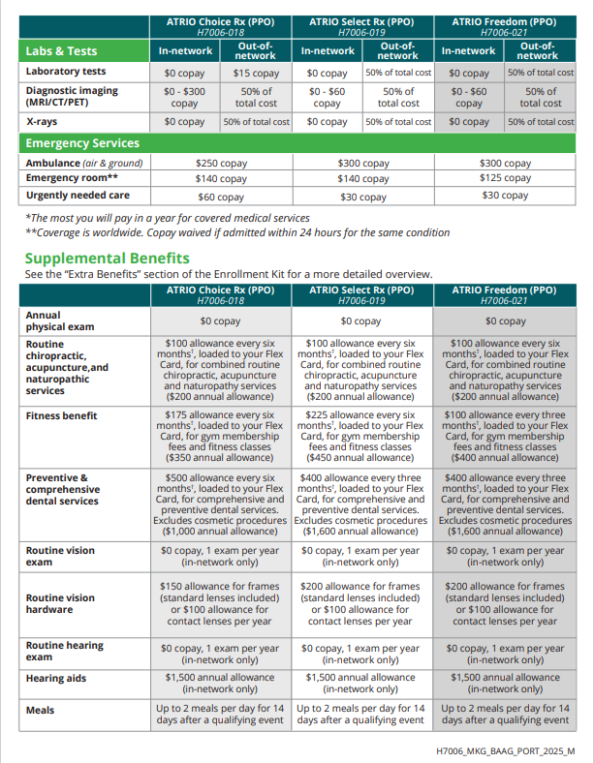
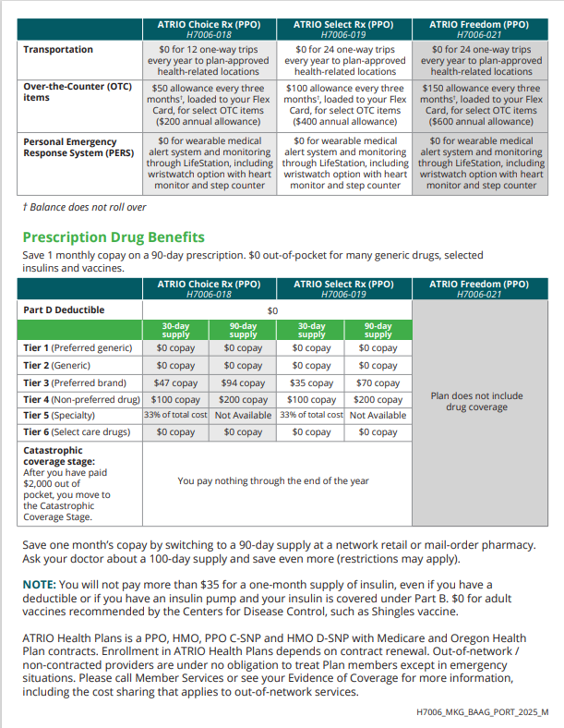
Clackamas, Lane, Multnomah, Washington, and Yamhill Counties
Confidential - Not Intended for Distribution

Slide 21
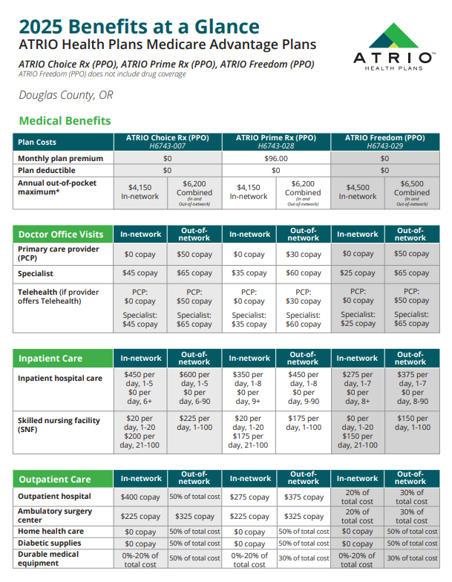
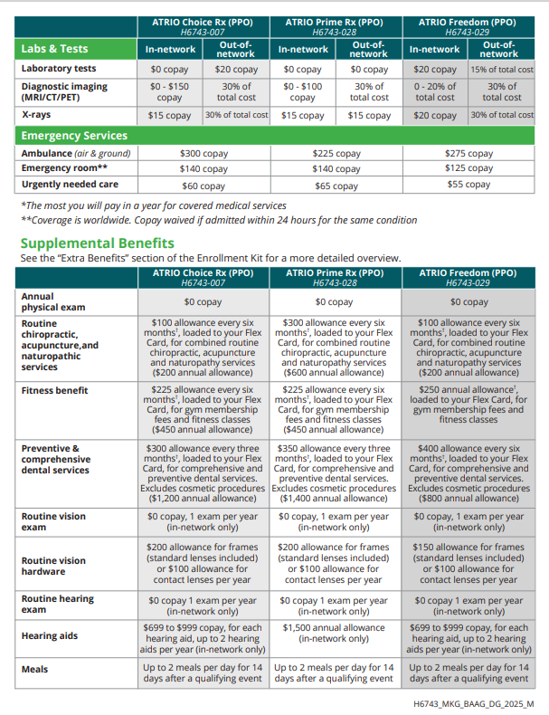
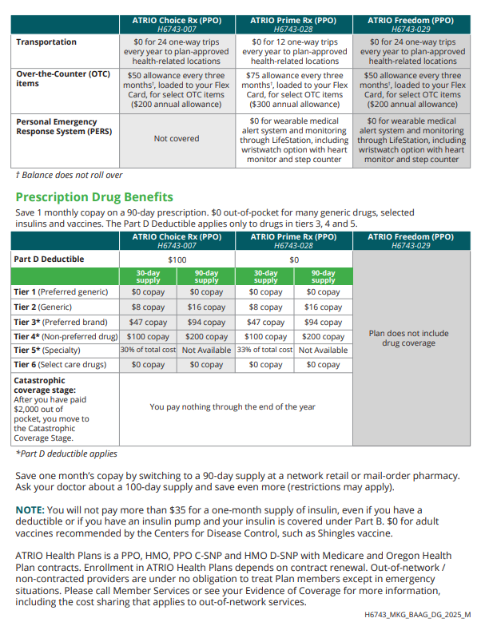
Douglas, OR
Confidential - Not Intended for Distribution

Slide 22
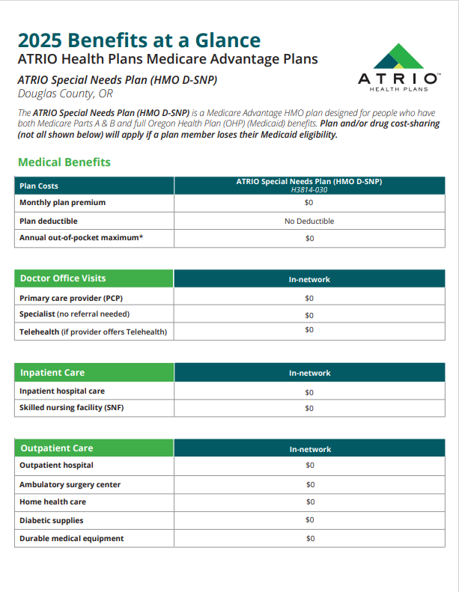
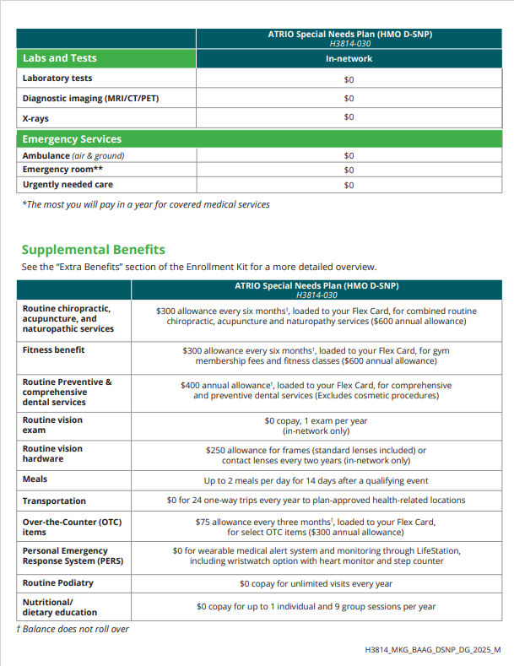
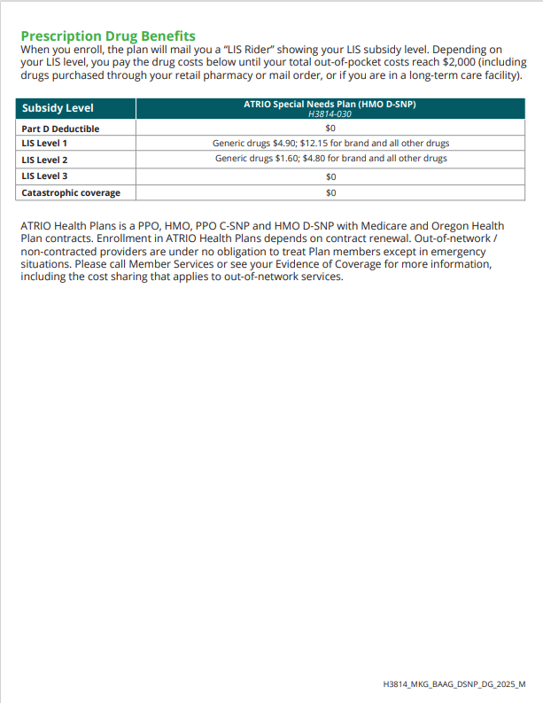
Douglas, OR
Confidential - Not Intended for Distribution

Slide 23
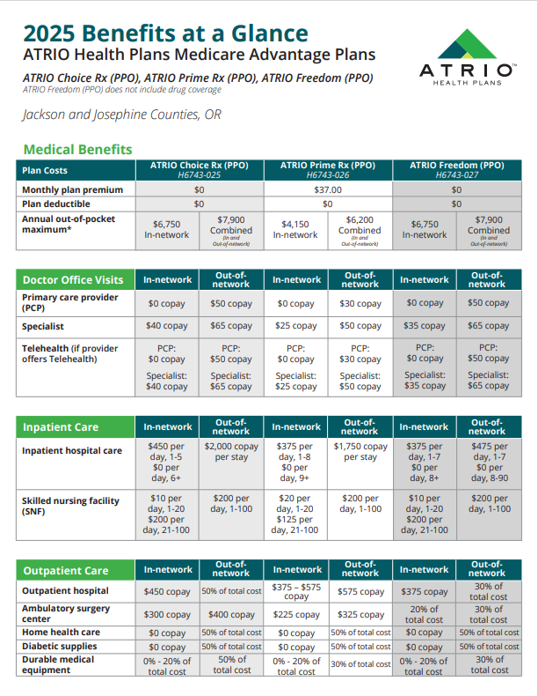
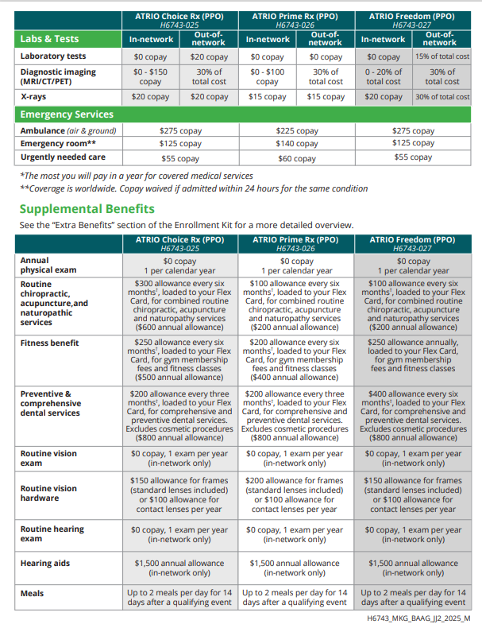
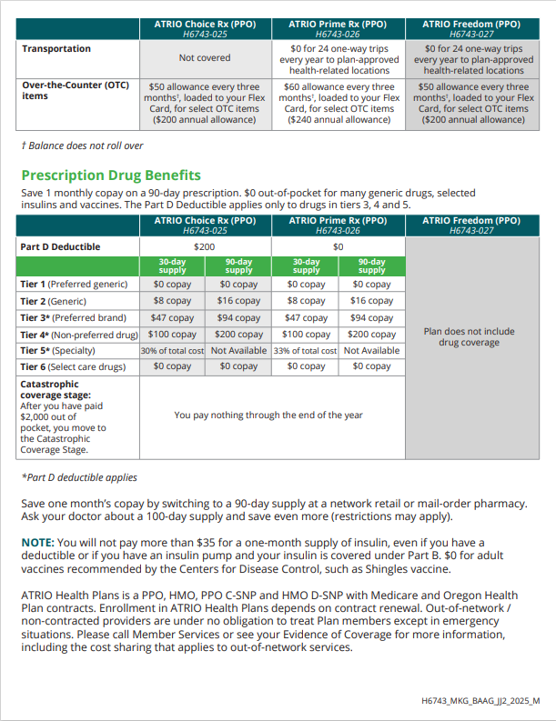
Jackson & Josephine Counties
Confidential - Not Intended for Distribution

Slide 24
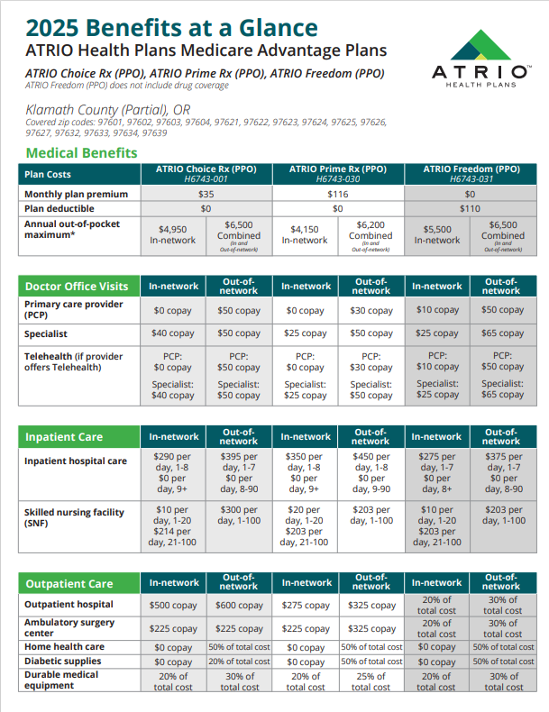
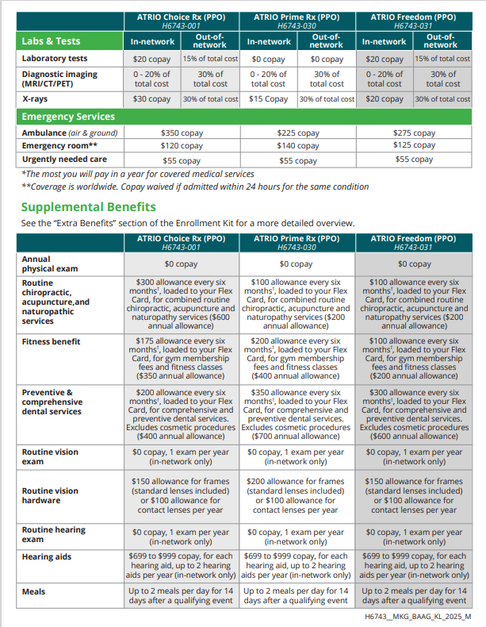
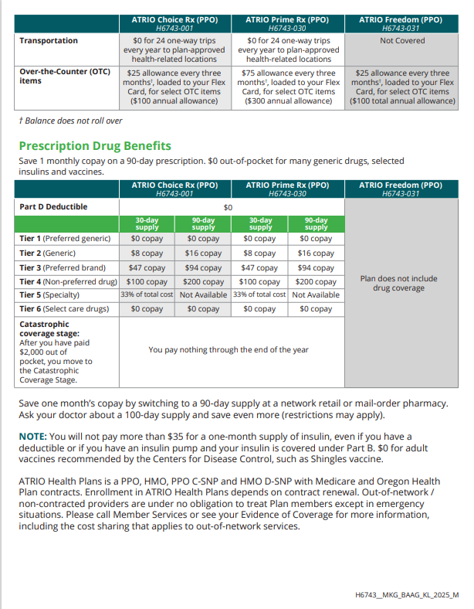
Klamath County
Confidential - Not Intended for Distribution

Slide 25
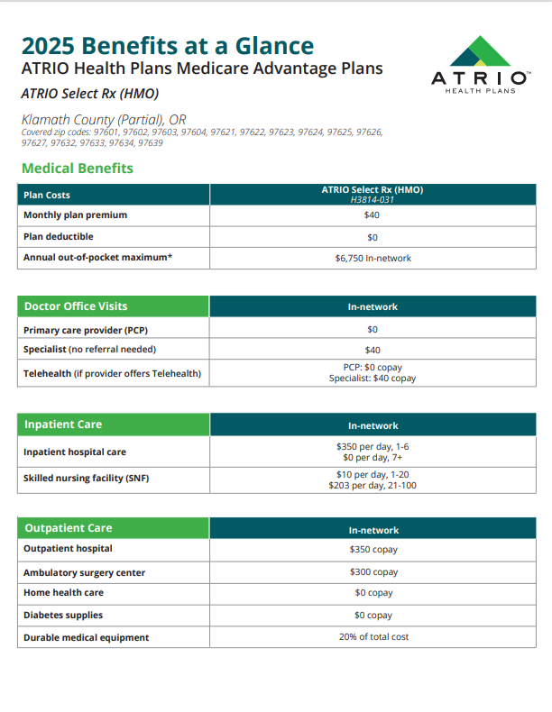
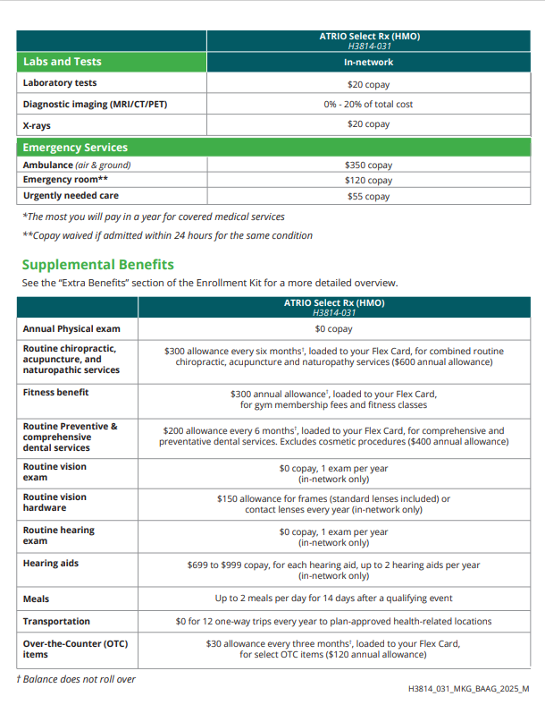
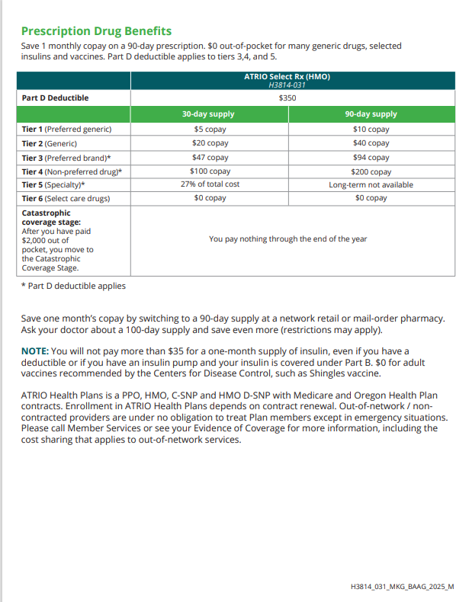
Klamath County
Confidential - Not Intended for Distribution

Slide 26
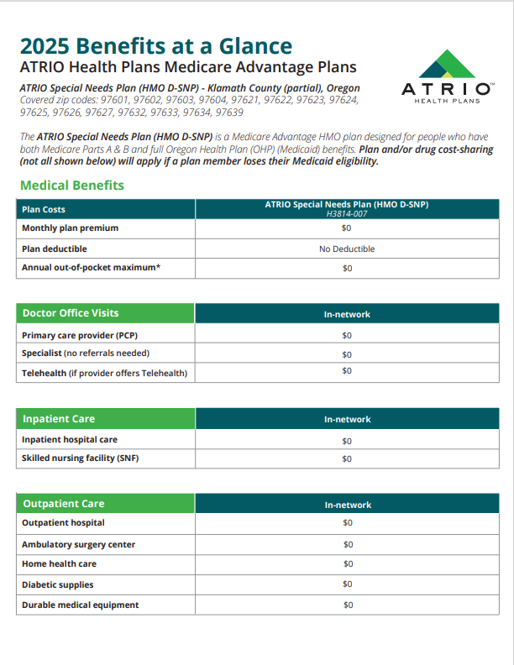
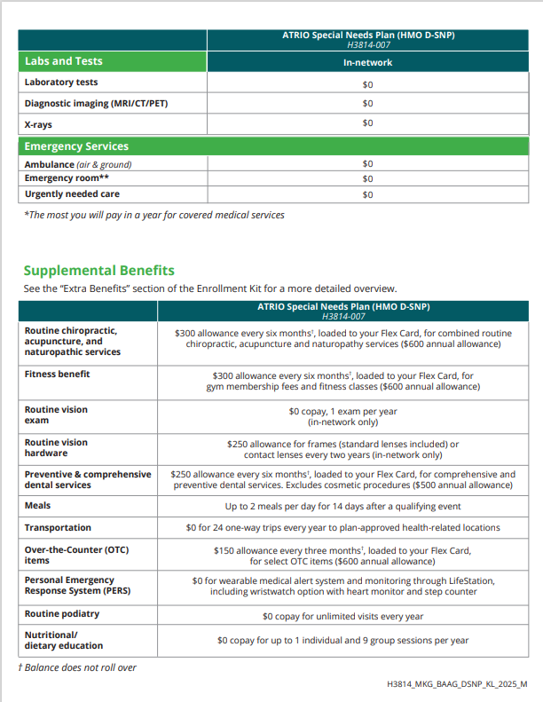
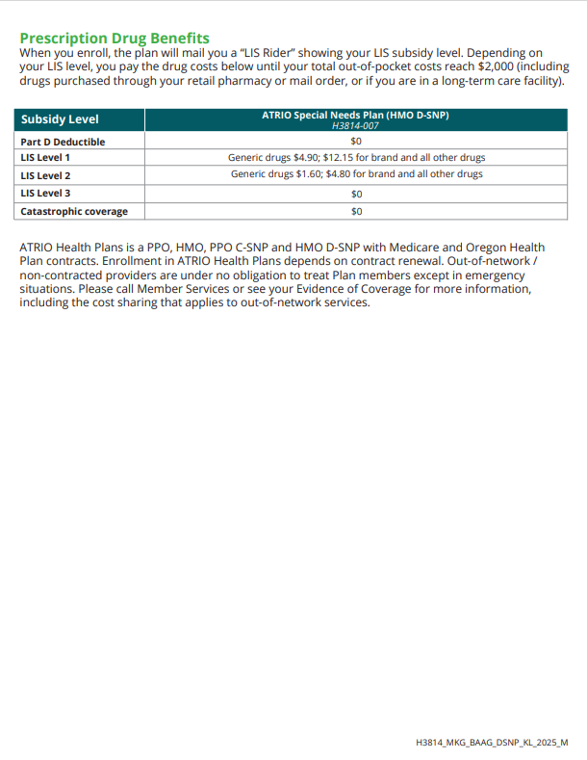
Klamath County
Confidential - Not Intended for Distribution

Slide 27
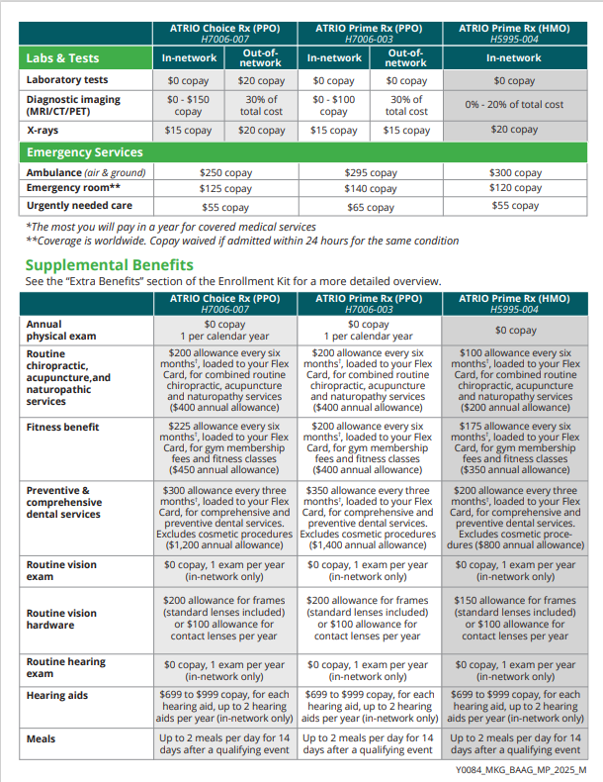
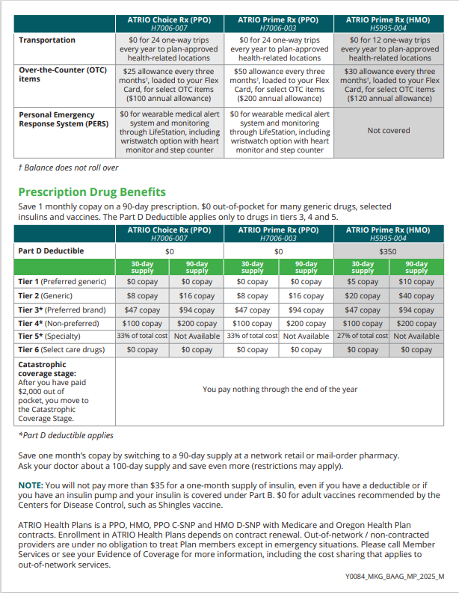
Marion & Polk Counties
Confidential - Not Intended for Distribution

Slide 28
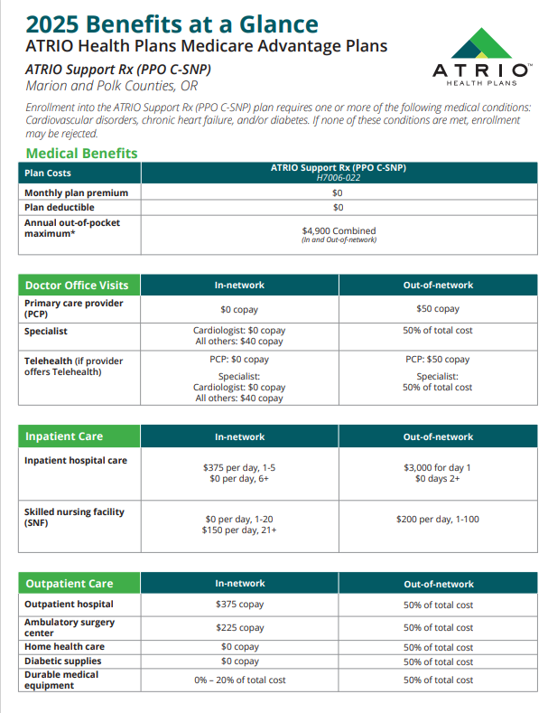
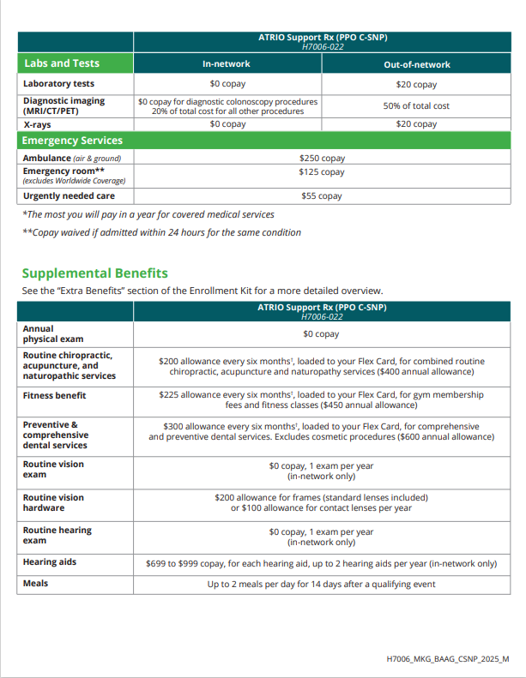
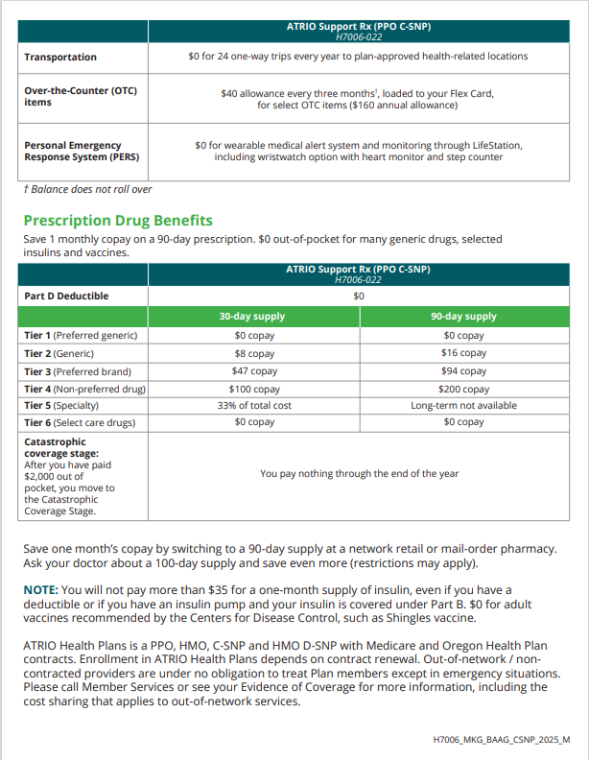
Marion & Polk Counties
Confidential - Not Intended for Distribution

Slide 29
Extra Benefits and Flex Card
Extra Benefits
When you choose ATRIO, you get extra benefits that Original Medicare does not cover. Your plan may include:
Flex Card
Every ATRIO Medicare Advantage plan features a Flex Card: a special debit card preloaded with dollars for Dental, Fitness, select Over-the-Counter (OTC) items and routine Alternative Therapies such as Chiropractic, Acupuncture, and Naturopathy services.
Vision
Routine Hearing
Meals
Worldwide Emergency
Dental
Fitness
Receive cash back each month in your Social Security check (most plans)
Personal Emergency Responsive System (PERS) Wearable medical alert system and monitoring (Not included in all plans)
Transportation on plan-approved health related locations (Not included in all plans)
Over the Counter
Routine Alternative
Therapies (Chiropractic, Acupuncture, and Naturopathy)
Confidential - Not Intended for Distribution

Slide 30
Star Ratings
How are Star Ratings determined?
The two main types of Star Ratings are:
An overall Star Rating that combines all of our plans’ scores
Summary Star Ratings that focus on medical (Part C) and our prescription drug services (Part D)
Some of the areas Medicare reviews for these ratings include:
How our members rate our plan’s services and care
How well our doctors detect illnesses and keep members healthy
How well our plan helps our members use recommended and safe prescription medications
Confidential - Not Intended for Distribution

Slide 31
Member Experience
Member ID Card
This card will contain all your member information, including important numbers (i.e., Member Services contact information) should you have any questions.
Flex Card (Visa)
Separately, you will also receive your ATRIO Flex Card in the mail, pre-loaded with allowances for dental, fitness, OTC and routine chiropractic/acupuncture/naturopathy services.
Confidential - Not Intended for Distribution

Slide 32
Member Experience
Welcome Packet
Local Support
Specific Plan Information
Quick Start Reference Guide
Member ID card
Accessing the member portal
Extra Benefit Information
Preventative Services and Assistance Selecting a Primary Care Provider
Visit local office
Contact Member Services with questions on your Plan Benefits, Claims, Lost/Stolen Member ID or Flex Cards, Provider Search, Pharmacy Team Assistance plus more! Open daily, 8:00 a.m. - 8:00 p.m. PST. 1-877-672-8620 (TTY 711)
Use the Chat function to speak with an ATRIO Member Services Representative, at atriohp.com. Mon-Fri, 8:30 a.m. -5:00 p.m. PST.
Email ATRIO Member Services at CustomerService@atriohp.com
Flex Card
Will be shipped separately from Welcome Packet
Flex Card plan benefits information (dental, fitness, OTC, routine chiropractic, acupuncture, naturopathy)
How-to use guide
Confidential - Not Intended for Distribution

Slide 33
Additional Resources for Medicare Beneficiaries
Medicare Shoppers Guide
Administration and Eldercare Locator
eldercare.acl.gov
Medicare Helpline
1-800-Medicare (1-800-633-4227)
State Resources
Medicare.gov
Social Security Administration
Confidential - Not Intended for Distribution

Slide 34
Need Help?
I am here for you.
Look up doctors, hospitals,
specialists and clinics to make sure they’re part of ATRIO Health Plans
Check your prescription drugs to make sure they’re included in the drug list and anticipated costs
Access additional services, including benefits available to ATRIO Health Plans members
ATRIO Health Plans works with the care you receive from the VA or TRICARE For Life coverage
Find out if you’re eligible for more benefits such as Extra Help

Slide 35
Ready to Enroll?
We are here to assist you!
[Agent Name]
Telephone
[123-456-7890]
Email
[hello@reallygreatsite.com]
Visit our ATRIO website
atriohp.com
ATRIO Health Plans is a PPO, HMO, PPO C-SNP, and HMO D-SNP with Medicare and Oregon Health Plans contracts. Enrollment in ATRIO Health Plans depends on contract renewal.
Confidential - Not Intended for Distribution
To file a grievance or compliant about marketing efforts with Medicare, contact 1-800-MEDICARE, 24 hours a day/7 day a week. Please provide your agent/broker’s name and plan if possible.
Y0084_MKG_SPres_2025_M

Slide 36
THANK YOU

